Slide 1
Network Security Basics

Slide 2
Understanding Network Devices & Cabling

Slide 3
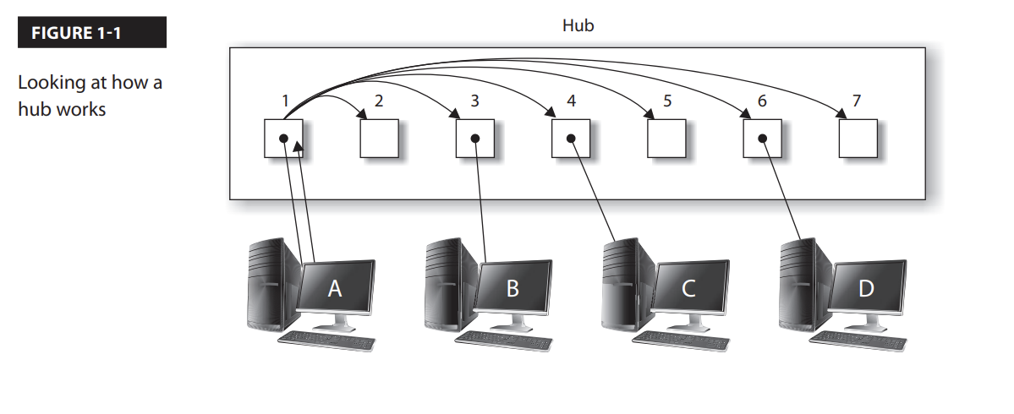
HUB:
The network hub is an older networking device that was used to connect all the systems together in a network environment.
The hub is a layer-1 device of the OSI (Open Systems Interconnection) model that simply receives a signal from one system and then sends the
signal to all other ports on the hub.
For example, looking at Figure 1-1, you can see that when Computer A sends data to Computer C, the data is received on port 1 of the hub and
then sent to all other ports.
The drawback to the hub is that it uses up bandwidth by sending the data to every port on the hub.

Slide 4
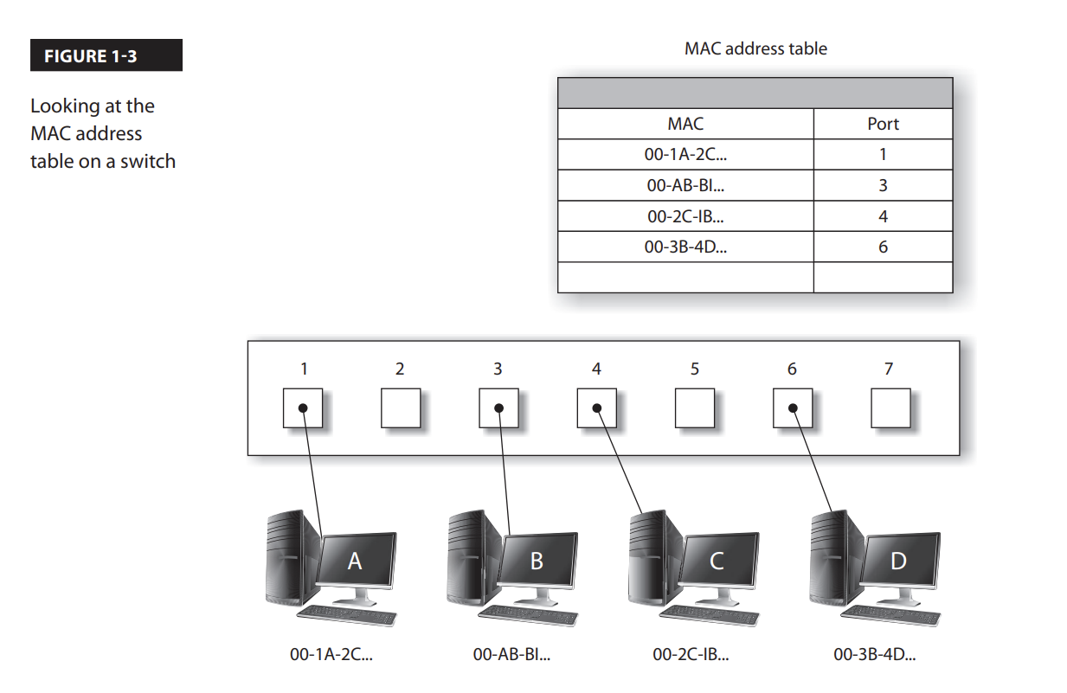
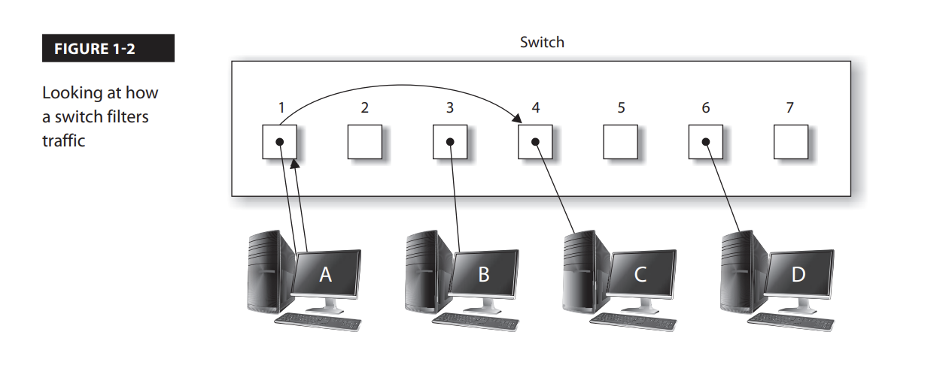
Switch:
A network switch is similar to a network hub in that it is used to connect all systems together in a network environment, but the difference is that a switch is a layer-2 device that filters traffic by the layer-2 address.
The switch is able to filter the traffic because it stores the MAC addresses of each system connected to the switch, and what port that system is connected to, in the MAC address table.
The MAC address table is a table stored in memory on the switch and is responsible for tracking what ports each system is connected to (see Figure 1-3).

Slide 5
Switch(Cont…)
Besides filtering traffic by sending the data only to the port that the destination system resides on, most network switches provide the following benefits:
■ Filtering:
As mentioned, a switch filters traffic, which prevents others from capturing and viewing potentially confidential information.
■ Port mirroring:
Port mirroring, also known as port monitoring, is a feature of some switches that allows the administrator to copy traffic from other ports to a single destination port (known as a monitoring port).
Because the switch filters traffic by default, the administrator cannot monitor network traffic.
The switch vendors had to come up with a way to copy all the traffic to a single port so the administrator could connect their monitoring system to that port.

Slide 6
Switch (Cont…)
■ Port security:
Port security is a feature of a network switch that lets you configure a port for a specific MAC address.
This allows you to control which systems can connect to that port on the switch. When an unauthorized system connects to the port on the switch, the switch can temporarily disable the port until the correct system is plugged into the switch, or have the port disabled until an administrator reenables the port.
Capability to disable ports:
If you have ports on the switch that are not being used, it is a security best practice to disable them so that they cannot be used.

Slide 7
Collision Domains:
Another important feature of a switch is known as a collision domain, which is a group of systems that share the same network segment and therefore can have their data collide with one another.
All ports on a hub create a single collision domain, but each port on a switch creates a separate collision domain.
For example, when using a network hub, if two systems were to send data at the same time it would result in a data collision.
This is because the hub creates a “shared” network segment that all systems have access to.
With a switch, each port on the switch creates a separate collision domain that is its own network segment.
When connecting a system to a port on a switch, because no other system is on the network segment, there won’t be data collisions.

Slide 8
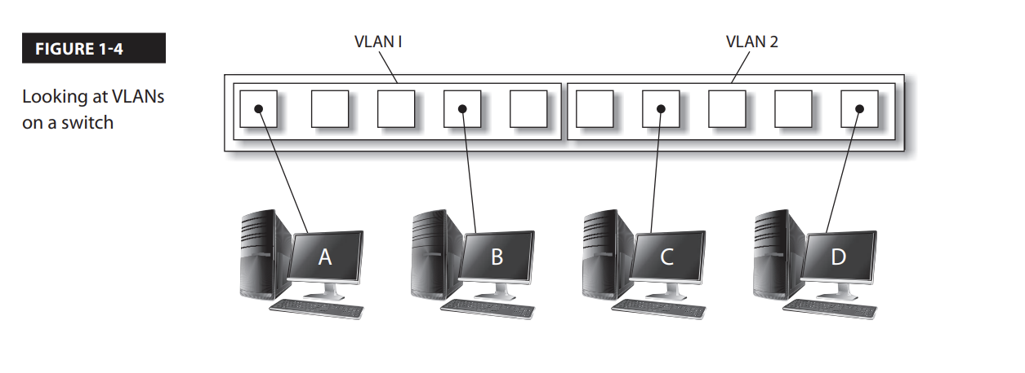
VLAN
Most switches today support a feature known as virtual LANs (VLANs).
The purpose of a VLAN is to create multiple networks within the one network switch.
One way to do this is by placing ports on the switch into VLAN groupings.
When a system is connected to a port on the switch, it becomes a member of the VLAN that the port is associated with.
The important point is that when a system is a member of one VLAN, it cannot communicate with systems in another VLAN. It’s as if each VLAN has its own switch with no connection to another switch.
Figure 1-4 displays a switch configured in two VLANs.
In this example, Computer A can communicate only with Computer B because they are the only systems in VLAN1.
Computer A and Computer B cannot communicate with Computer C and Computer D because communication across VLANs is not allowed without a router

Slide 9
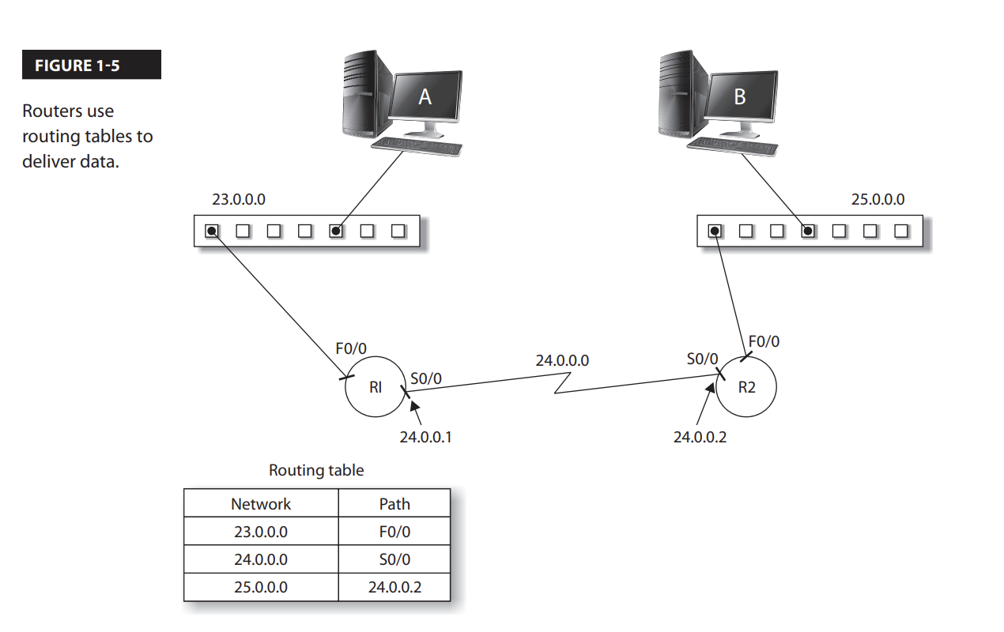
Router
A router is a layer-3 device that is responsible for routing, or sending, data from one network to another network.
The router uses a routing table that resides in its memory to determine the networks it knows how to send data to.
Figure 1-5 displays a network topology and the routing table on a router.
Notice in the figure that in order for router R1 to send data to the 25.0.0.0 network, it must send the data to the 24.0.0.2 address, as indicated by the routing table

Slide 10
Load Balancer
A load balancer is a device that is designed to split the load between components such as servers or routers.
Load balancing is the concept of trying to improve performance.
Instead of having a single server or device handle all the work, you have multiple servers or devices that the workload is divided among.
This increases overall performance because you have more systems working at the same time to handle all the incoming requests.

Slide 11
Load Balancer (Cont…)
Load balancers have a number of settings that allow you to configure how the load balancer works:
■ Round-robin:
Sends the request from a client to each back-end server in order.
The load balancer has a list of servers and simply goes through them in order.
■ Affinity:
Controls whether all requests from a client go to the same server in the load balancer or if each request can potentially be routed to a different server.
Affinity essentially ties a client to a particular server.
■ Persistence:
This is another method used to associate a client with a specific server within the load balancer.
With persistence, the user’s session cookie is used to ensure that the same server is handling all requests from the client (this is also known as a sticky session). This session cookie could come from the application or the load balancer itself.
Scheduling
Specifies which algorithm will be used to send the request to one of the nodes.
Scheduling uses a number of configuration values, such as round-robin, affinity, and CPU load, to determine to which server to send the request.

Slide 12
Load Balancing Technique (Active/Passive vs. Active/Active)
There are two common configurations for load balancing.
With an active/passive configuration, one system, called a node, handles all the work (the active node), while the other node (the passive node) is on standby, ready to take over if the active node fails.
If the active node fails, the passive node becomes the active node and handles all the workload.
With an active/active configuration, both nodes are online and able to handle requests, essentially splitting the workload.
If one node fails, the other node handles all the workload until the failed node is recovered.
With both configurations, more than two nodes can be included for extra redundancy.
With both of these setups, the load balancer has an IP address assigned to it (known as the virtual IP), and you configure all clients to send requests to the virtual IP assigned to the load balancer.
When the load balancer receives a request sent to the virtual IP, it then forwards the request to an active node in the load balancer.

Slide 13
Load Balancing Technique (DNS Round robin)
Round-robin DNS is a load balancing technique where the balancing is done by a type of DNS server called an authoritative nameserver, rather than using a dedicated piece of load-balancing hardware.
Round-robin DNS can be used when a website or service has their content hosted on several redundant web servers; when the DNS authoritative nameserver is queried for an IP address, the server hands out a different address each time, operating on a rotation.
This is particularly useful when the redundant web servers are geographically separated, making traditional load-balancing difficult.
Round-robin is known for it’s ease of implementation, but it also has strong drawbacks.
The problem with round-robin is that the solution doesn’t verify if that server is actually up and running without problems.
An example of round-robin load balancing is the use of the Domain Name System (DNS).
You can create multiple DNS records with the same name but different IP addresses, and the DNS server will send a different IP address with each response to the clients.
The problem is that the DNS server does not verify that those IP addresses are used by systems that are up and running

Slide 14
Firewalls & Proxy Servers
A firewall is a network device that controls which traffic is allowed to enter or leave the network.
The firewall filters traffic based on rules you place on the firewall indicating which traffic is allowed or not allowed to enter or leave the network.
You typically start with a deny-all rule that states all traffic is denied, unless you specify otherwise by building a rule for a specific type of traffic.
A proxy server is a device that all clients send their Internet traffic to, and then the proxy server sends the requests to the Internet on behalf of the users.
The proxy server typically implements network address translation (NAT) as well, helping to keep the internal network structure private from the outside world.

Slide 15
Self-Study
Understanding network cabling
Understanding IP addresses
Understanding Transport Layer Protocols (TCP & UDP)

Slide 16

Cabling A brief journey towards network wiring

Slide 17

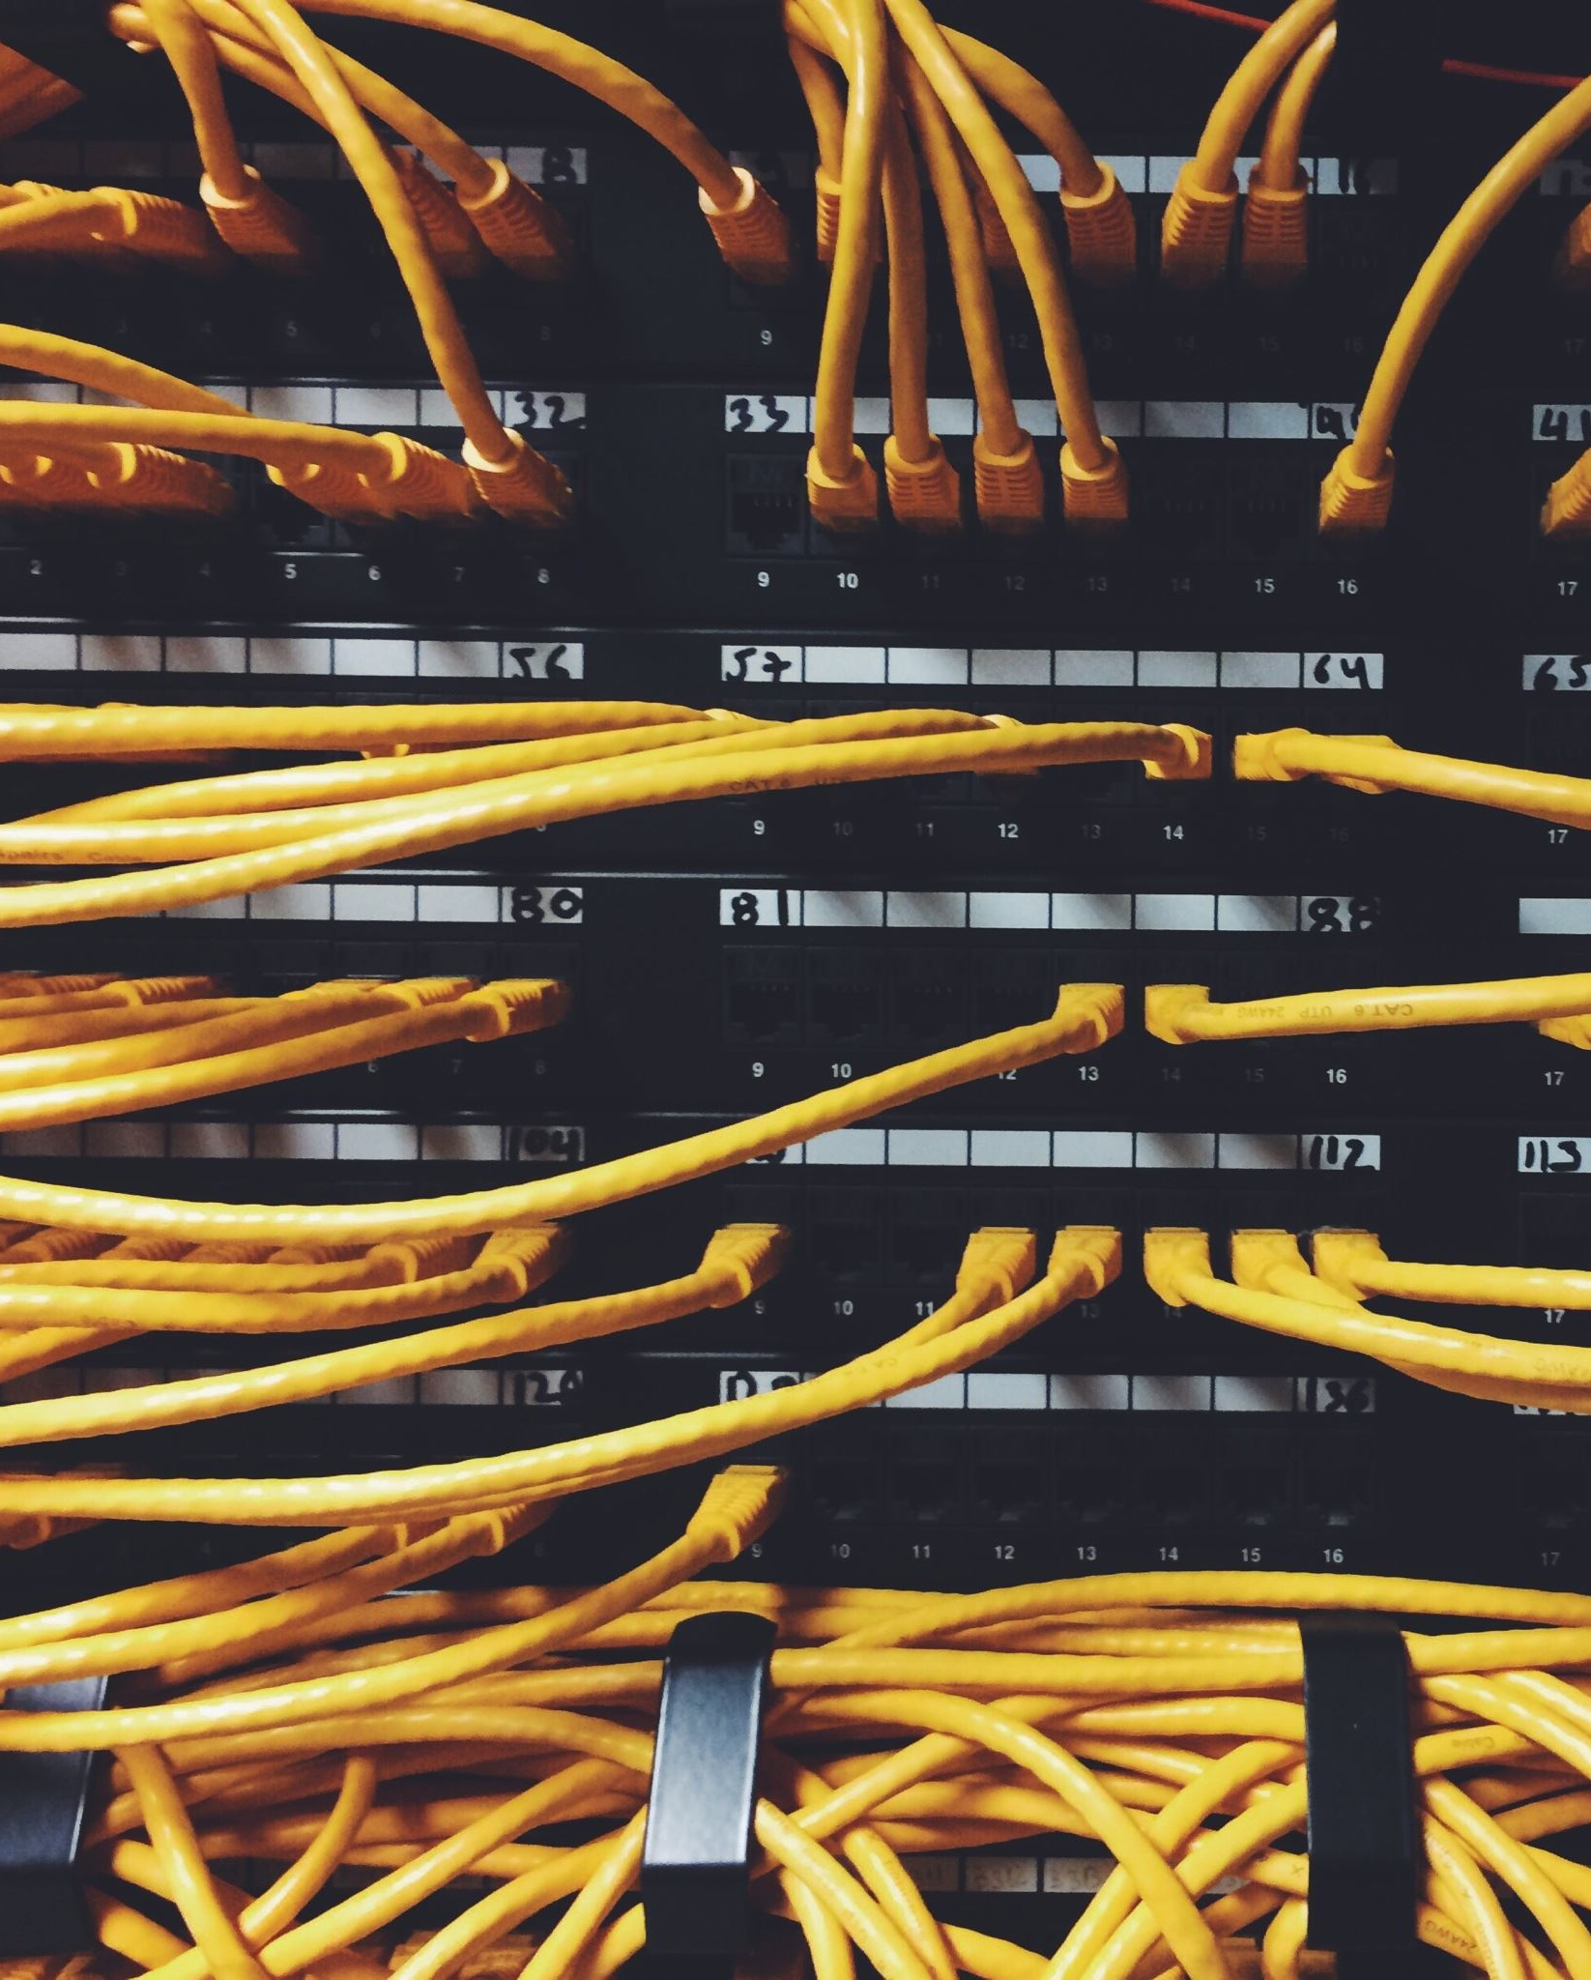
The Importance of Reliable Cabling
Data cabling typically accounts for less than 10 percent of the total cost of the network infrastructure.
● The life span of the typical cabling system is upwards of 16 years. Cabling is likely the second most long-lived asset you have (the first being the shell of the building).
● Nearly 70 percent of all network-related problems are due to poor cabling techniques and cable-component problems.
If you have installed the proper Category or grade of cable, the majority of cabling problems will usually be related to patch cables, connectors, and termination techniques. The permanent portion of the cable (the part in the wall) will not likely be a problem unless it was damaged during installation.

Slide 18
The Cost of Poor Cabling
The costs that result from poorly planned and poorly implemented cabling systems can be staggering.
One company that had recently moved into a new office space used the existing cabling, which was supposed to be Category 5 cable.
Almost immediately, 100Mbps Ethernet network users reported intermittent problems. These problems included exceptionally slow access times when reading e–mail, saving documents, and using the sales database.
After many months of network annoyances, the company finally had the cable runs tested.
Many cables did not even meet the minimum requirements of a Category 5 installation, and other cabling runs were installed and terminated poorly

Slide 19
Cabling and the Need for Speed
The past few years have seen some tremendous advances not only in networking technologies but also in the demands placed on them.
In the past 20 years, we have seen the emergence of standards for 10Mb Ethernet, 16Mb Token Ring, 100Mb FDDI, 100Mb Ethernet, 155Mb ATM (Asynchronous Transfer Mode), 655Mb ATM, 1Gb Ethernet, 2.5Gb ATM., and 10Gb Ethernet (over optical fiber only as of this writing).
Network technology designers are already planning technologies to support data rates of up to 100Gbps.

Slide 20
Cont…
The average number of nodes on a network segment has decreased dramatically, while the number of applications and the size of the data transferred has increased dramatically.
Applications are becoming more complex, and the amount of network bandwidth required by the typical user is increasing.

Slide 21
Types of Communication Media
Four major types of communications media (cabling) are available for data networking today: unshielded twisted pair (UTP), shielded or screened twisted pair (STP or ScTP), coaxial, and fiber optic (FO).
It is important to distinguish between backbone cables and horizontal cables.
Backbone cables connect network equipment such as servers, switches, and routers and connect equipment rooms and communication closets.
Horizontal cables run from the communication closets to the wall outlets.
For new installations, multistrand fiber-optic cable is essentially universal as backbone cable.

Slide 22
Twisted-Pair Cable
By far the most economical and widely installed cabling today is twisted-pair wiring.
Not only is twisted-pair wiring less expensive than other media, installation is also simpler, and the tools required to install it are not as costly.
Unshielded twisted pair (UTP) and shielded twisted pair (STP) are the two primary varieties of twisted pair on the market today.
Screened twisted pair (ScTP) is a variant of STP.

Slide 23
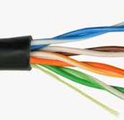
Unshielded Twisted Pair (UTP)
Unshielded twisted pair (UTP) for LANs first became common in the late 1980s with the advent of Ethernet over twisted-pair wiring and the 10Base-T standard.
UTP is cost effective and simple to install, and its bandwidth capabilities are continually being improved.
UTP cabling typically has only an outer covering (jacket) consisting of some type of nonconducting material.
This jacket covers one or more pairs of wire that are twisted together.

Slide 24
Cont..
This simple cable consists of a jacket that surrounds four twisted pairs.
Each wire is covered by an insulation material with good dielectric properties.
For data cables, this means that in addition to being electrically nonconductive, it must also have certain properties that allow good signal propagation.
Its great popularity is mostly due to the cost and ease of installation.
With every new generation of UTP cable, network engineers think they have reached the limits of the UTP cable’s bandwidth and capabilities.

Slide 25
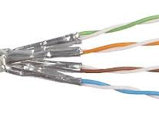
Shielded Twisted Pair (STP)
Shielded twisted-pair (STP) cabling was first made popular by IBM when it introduced Type classification for data cabling.
Though more expensive to purchase and install than UTP, STP offers some distinct advantages.
STP cable is less susceptible to outside electromagnetic interference (EMI) than UTP cabling because all cable pairs are well shielded

Slide 26
Cont….
Simply installing STP cabling does not guarantee you will improve a cable’s immunity to EMI or reduce the emissions from the cable.
Several critical conditions must be met to achieve good shield performance:
● The shield must be electrically continuous along the whole link.
● All components in the link must be shielded. No UTP patch cords can be used.
● The shield must fully enclose the pair, and the overall shield must fully enclose the core. Any gap in the shield covering is a source of EMI leakage.
● The shield must be grounded at both ends of the link, and the building grounding system must conform to grounding standards (such as TIA/EIA-607).

Slide 27
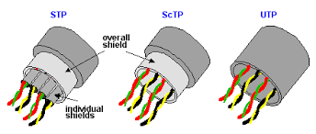
Screened Twisted Pair (ScTP)
A recognized cable type in the ANSI/TIA/EIA-568-B Standard is screened twisted-pair (ScTP) cabling, a hybrid of STP and UTP cable.
ScTP cable contains four pairs of 24 AWG, 100-ohm wire surrounded by a foil shield or wrapper and a drain wire for bonding purposes.
ScTP is also sometimes called foil twisted-pair (FTP) cable because the foil shield surrounds all four conductors.
ScTP cable is essentially STP cabling that does not shield the individual pairs; the shield may also be smaller than some varieties of STP cabling

Slide 28
Cont…
The foil shield is the reason ScTP is less susceptible to noise.
In order to implement a completely effective ScTP system, however, the shield continuity must be maintained throughout the entire channel—including patch panels, wall plates, and patch cords.
Standard eight-position modular jacks (commonly called RJ-45s) do not have the ability to ensure a proper ground through the cable shield.
So special mating hardware, jacks, patch panels, and even tools must be used to install an ScTP cabling system.
Many manufacturers of ScTP cable and components exist—just make sure to follow all installation guidelines.

Slide 29
Not All UTP Is Created Equal!
Though two cables may look identical, their supported data rates can be dramatically different.
Older UTP cables that were installed to support telephone systems may not even support 10Base-T Ethernet.
The ANSI/TIA/EIA-568-B Standard helps consumers choose the right cable (and components) for the right application.
The Standard has been updated over the years and currently defines four categories of UTP cable: Categories 3, 5, 5e, and 6.
Note that Category 5 requirements have been moved to an addendum and are not officially recognized as an approved cable for new installations.

Slide 30
Cont…
Category 1 (not defined by ANSI/TIA/EIA-568-B) :
This type of cable usually supports frequencies of less than 1MHz.
Common applications include analog voice telephone systems.
It never existed in any version of the 568 Standard.
Category 2 (not defined by ANSI/TIA/EIA-568-B):
This cable type supports frequencies of up to 4MHz.
It’s not commonly installed, except in installations that use twisted-pair ArcNet and Apple LocalTalk networks.
Its requirements are based on the original, proprietary IBM Cabling System.
It never existed in any version of the 568 Standard.
Category 3 (recognized cable type in ANSI/TIA/EIA-568-B):
This type of cable supports data rates up to 16MHz.
This cable was the most common variety of UTP for a number of years starting in the late 1980s.
Common applications include 4Mbps UTP Token Ring, 10Base-T Ethernet, 100Base-T4, and digital and analog telephone systems.
Its inclusion in the 568-B Standard is for voice applications.

Slide 31
Cont….
Category 4 (not defined by ANSI/TIA/EIA-568-B):
Cable belonging to Category 4 was designed to support frequencies of up to 20MHz, specifically in response to a need for a UTP solution for 16Mbps Token Ring LANs.
It can support voice data upto 16Mbps
It was quickly replaced in the market when Category 5 was developed, as Category 5 gives five times the bandwidth with only a small increment in price.
Category 4 was a recognized cable in the 568-A Standard, but it has been dropped from ANSI/TIA/EIA-568-B.

Slide 32
Cont….
Category 5 (included in ANSI/TIA/EIA-568-B for informative purposes only)
Category 5 was the most common cable installed, until new installations began to use an enhanced version.
It may still be the cable type most in use because it was the cable of choice during the huge infrastructure boom of the 1990s.
It was designed to support frequencies of up to 100MHz.
Applications include 100Base-TX, PMD (FDDI over copper), 155Mbps ATM over UTP, and thanks to sophisticated encoding techniques, 1000Base-T Ethernet.

Slide 33
Cont…
Category 5e (recognized cable type in ANSI/TIA/EIA-568-B)
Category 5e (enhanced Category 5) was introduced with the TIA/EIA-568-A-5 addendum of the cabling Standard.
Even though it has the same rated bandwidth as Category 5, i.e., 100MHz, additional performance criteria and a tighter transmission test requirement make it more suitable for high-speed applications such as Gigabit Ethernet.
Applications are the same as those for Category 5 cabling.
It is now the minimum recognized cable category for data transmission in ANSI/TIA/EIA-568-B.

Slide 34
Cont….
Category 6 (recognized cable type in ANSI/TIA/EIA-568-B)
Category 6 cabling was officially recognized with the publication of an addition to ANSI/TIA/EIA-568-B in June 2002.
In addition to more stringent performance requirements as compared to Category 5e, it extends the usable bandwidth to 200MHz.
Its intended use is for Gigabit Ethernet and other future high-speed transmission rates.
Successful application of Category 6 cabling requires closely matched components in all parts of the transmission channel, i.e., patch cords, connectors, and cable.

Slide 35
Coaxial Cable
At one time, coaxial cable was the most widely used cable type in the networking business.
It is still widely used for closed-circuit TV and other video distribution.
However, it is falling by the wayside in the data-networking arena.
Coaxial (or just coax) cable is difficult to run and is generally more expensive than twisted-pair cable.
In defence of coaxial cable, however, it provides a tremendous amount of bandwidth and is not as susceptible to outside interference as is UTP.
Overall installation costs might also be lower than for other cable types because the connectors take less time to apply.

Slide 36
Optical-Fiber Cable
As late as 1993, it seemed that in order to move toward the future of desktop computing, businesses would have to install fiber-optic cabling directly to the desktop.
Although for most of us fiber to the desktop is not yet a practical reality, fiber-optic cable is touted as the ultimate answer to all our voice, video, and data transmission needs and continues to make inroads in the LAN market.

Slide 37
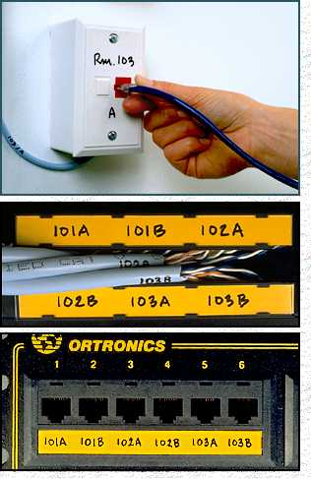
Structured Cabling Infrastructure
Cabling
Mounted and permanent
Allows patching
Comfort that infrastructure is OK
Components:
Information Outlet with Face Plate
Patch Panel
UTP Cable
Patch Cord

Slide 38
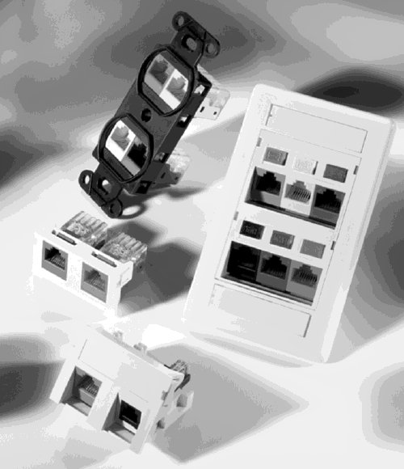
I/O & Faceplates
Cabling
Faceplate mounts on or in wall or in raceway
Single or Dual Information Outlet (I/O)
Provide network connectivity to the Hosts through a Patch Cord

Slide 39
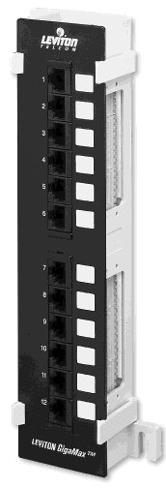
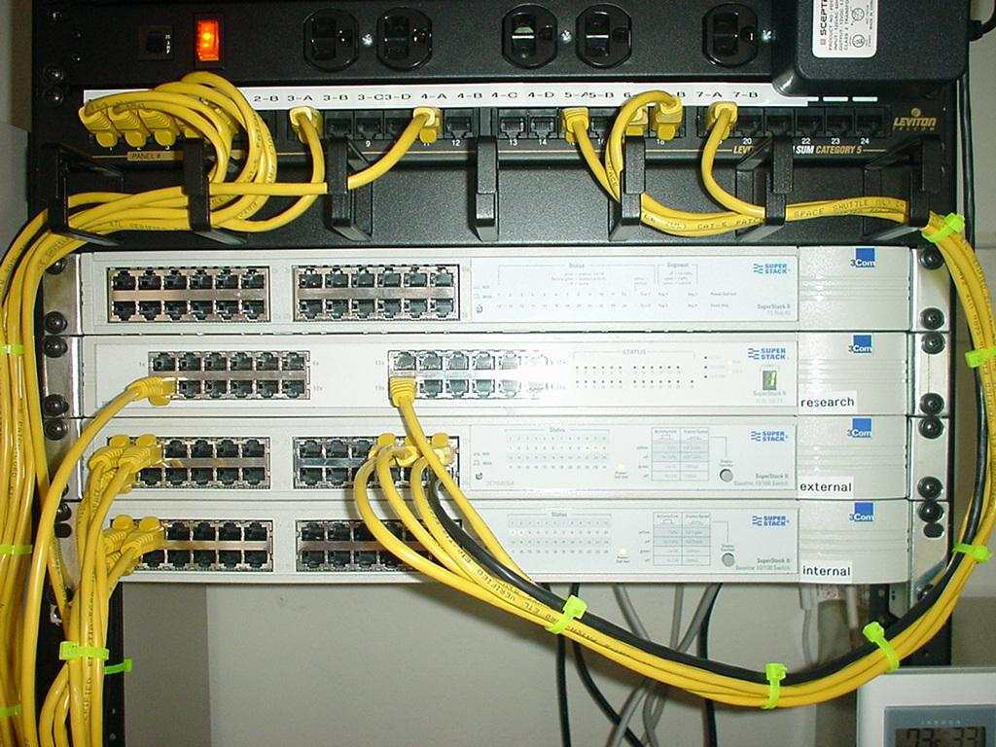
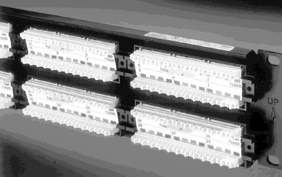
Patch Panel
Cabling
Termination punch down in back
Patch cord plugin in front

Slide 40
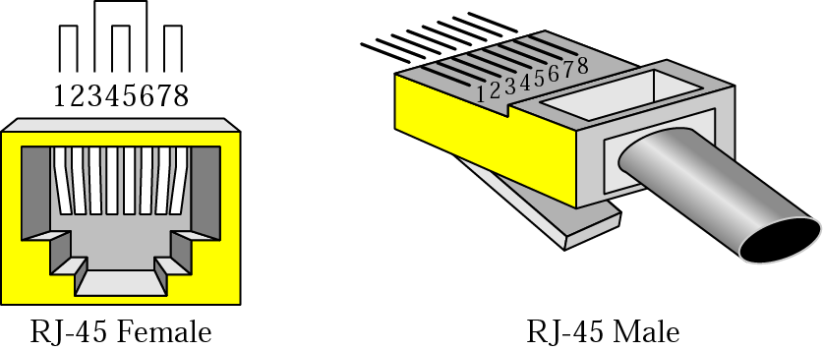
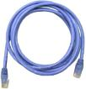
Patch Cord & UTP Connectors
Cabling

Slide 41
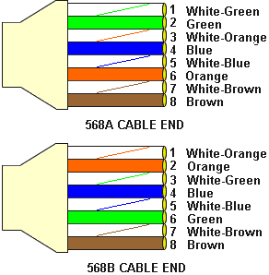
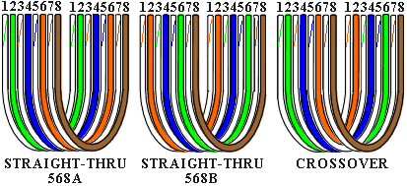
Color Codes
Cabling
Data Tx: 1 & 2
Data Rx: 3 & 6
Crossover
1 ⬄ 3
2 ⬄ 6
PoE +VDC: 4 & 5
PoE -VDC: 7 & 8

Slide 42

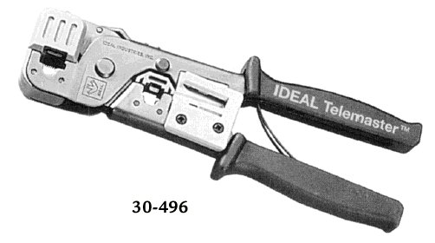
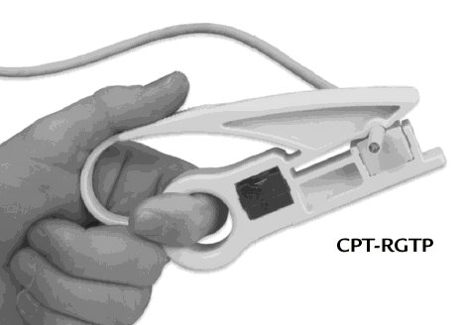
Cutting, Striping & Crimping Tools
Cabling
Make your own patch cords
Cuts and strips pairs
RJ45 end crimped onto ends of wire

Slide 43
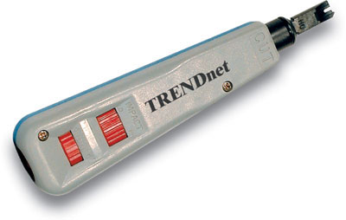
Punching Tool
Cabling
Terminates wires to back of patch panels and in Information Outlets

Slide 44

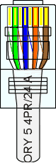

Making Cables
Cabling

Slide 45
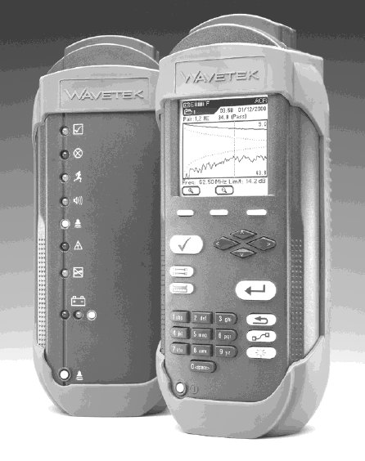
Wire Testing Equipment
Cabling
Test wire for correct termination of 8 wires
Test for speed capabilities

Slide 46
Cabling Rules
Cabling
Try to avoid running cables parallel to power cables.
Do not bend cables to less than four times the diameter of the cable.
If you bundle a group of cables together with cable ties (zip ties), do not over-cinch them. You should be able to turn the tie with fingers.
Keep cables away from devices which can introduce noise into them. Here's a short list: copy machines, electric heaters, speakers, printers, TV sets, fluorescent lights, copiers, welding machines, microwave ovens, telephones, fans, elevators, motors, electric ovens, dryers, washing machines, and shop equipment.
Avoid stretching UTP cables (tension when pulling cables should not exceed 25 LBS).
Do not run UTP cable outside of a building. It presents a very dangerous lightning hazard!
Do not use a stapler to secure UTP cables. Use telephone wire/RJ6 coaxial wire hangers which are available at most hardware stores.

Slide 47
STRAIGHT THROUGH AND CROSSOVER WIRING
Wiring within a twisted pair cable is configured as either
Straight through, where each wire (or pin) is attached to the same contact point at each end(different device)
Crossover, where transmit contacts on each end of the cable are connected to the receive contact at the other end(same device)

Slide 48
STRAIGHT THROUGH WIRING

Slide 49
CROSSOVER WIRING

Slide 50
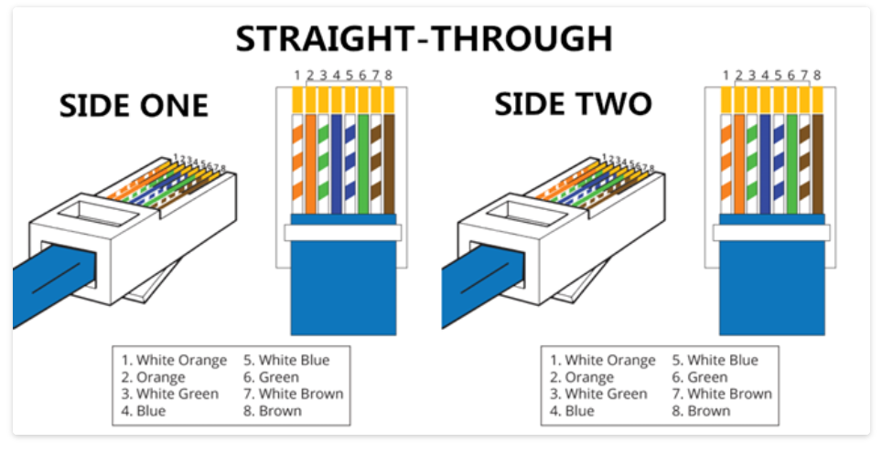
What Is Straight Through Cable?
A straight through cable is a type of twisted pair cable that is used in local area networks to connect a computer to a network hub such as a router.
This type of cable is also sometimes called a patch cable and is an alternative to wireless connections where one or more computers access a router through a wireless signal.
On a straight through cable, the wired pins match.
Straight through cable use one wiring standard:
both ends use T568A wiring standard or both ends use T568B wiring standard.

Slide 51
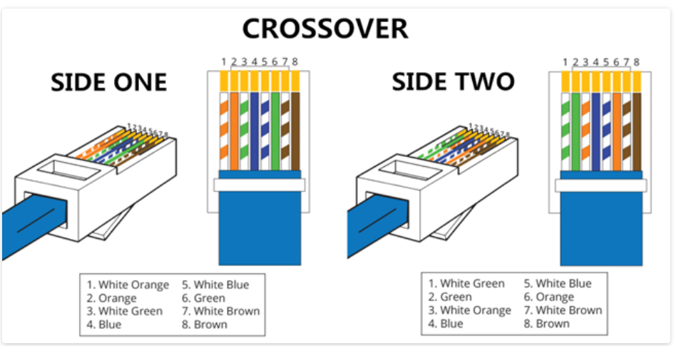
What Is Crossover Cable?
A crossover Ethernet cable is a type of Ethernet cable used to connect computing devices together directly.
Unlike straight through cable, the RJ45 crossover cable uses two different wiring standards: one end uses the T568A wiring standard, and the other end uses the T568B wiring standard.
The internal wiring of Ethernet crossover cables reverses the transmit and receive signals.
It is most often used to connect two devices of the same type: e.g. two computers (via network interface controller) or two switches to each other.

Slide 52
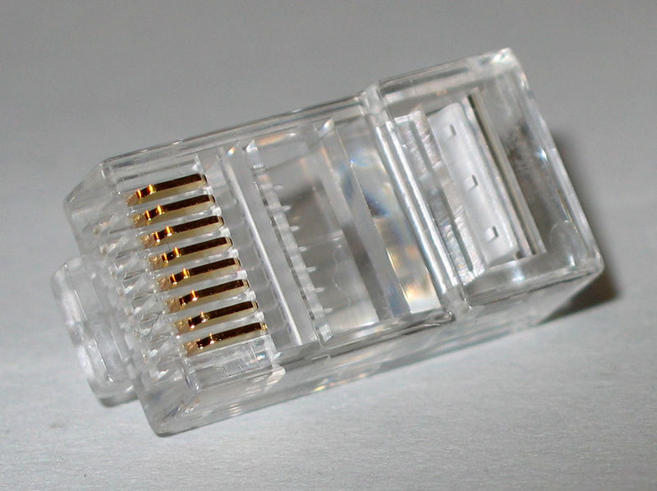
RJ45 connector

Slide 53

Making connections - Tools
Cat5e cable
RJ45 connectors
Cable stripper
Scissors
Crimping tool

Slide 54
IP Addressing

Slide 55
Purpose of an IP address
Unique Identification of
Source Sometimes used for security or policy-based filtering of data
Destination So the networks know where to send the data

Slide 56
Purpose of an IP Address
Identifies a machine’s connection to a network
Physically moving a machine from one network to another requires changing the IP address
TCP/IP uses unique 32-bit addresses

Slide 57
IP Address Allocation
Private IP address ranges:
10/8 (10.0.0.0 – 10.255.255.255)
192.168/16 (192.168.0.0 – 192.168.255.255)
172.16/12 (172.16.0.0 – 172.31.255.255)
Public IP address space
Assigned by an appropriate authority such as RIPE, ARIN, AFRINIC, etc. or Local Internet Registries (LIRs)
Public Address space for the Africa Region available from AfriNIC
Choose a small block from whatever range you have, and subnet your networks (to avoid problems with broadcasts)

Slide 58
IP Address Classes
IP addresses are divided into 5 classes, each of which is designated with the alphabetic letters A to E.
Class D addresses are used for multicasting.
Class E addresses are reserved for testing & some mysterious future use.

Slide 59
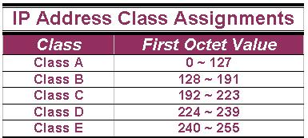
IP Address Classes (Cont.)
The 5 IP classes are split up based on the value in the 1st octet:

Slide 60
IP Address Classes (Cont.)
Using the ranges, you can determine the class of an address from its 1st octet value.
An address beginning with 120 is a Class A address, 155 is a Class B address & 220 is a Class C address.

Slide 61
Are You the Host or the Network?
The 32 bits of the IP address are divided into Network & Host portions, with the octets assigned as a part of one or the other.
Network & Host Representation
By IP Address Class
Class
Octet1
Octet2
Octet3
Octet4
Class A
Network
Host
Host
Host
Class B
Network
Network
Host
Host
Class C
Network
Network
Network
Host

Slide 62
Are You the Host or the Network? (Cont.)
Each Network is assigned a network address & every device or interface (such as a router port) on the network is assigned a host address.
There are only 2 specific rules that govern the value of the address.
A host address cannot be designated by all zeros or all ones.
These are special addresses that are reserved for special purposes.

Slide 63
Class A Addresses
Class A IP addresses use the 1st 8 bits (1st Octet) to designate the Network address.
The 1st bit which is always a 0, is used to indicate the address as a Class A address & the remaining 7 bits are used to designate the Network.
The other 3 octets contain the Host address.
There are 128 Class A Network Addresses, but because addresses with all zeros aren’t used & address 127 is a special purpose address, 126 Class A Networks are available.

Slide 64
Class A Addresses (Cont.)
There are 16,777,214 Host addresses available in a Class A address.
Rather than remembering this number exactly, you can use the following formula to compute the number of hosts available in any of the class addresses, where “^{n}” represents the number of bits in the host portion:
(2^{n} – 2) = Number of available hosts

Slide 65
Class A Addresses (Cont.)
For a Class A network, there are:
2²⁴ – 2 or 16,777,214 hosts.
Half of all IP addresses are Class A addresses.
You can use the same formula to determine the number of Networks in an address class.
Eg., a Class A address uses 7 bits to designate the network, so (2⁷ – 2) = 126 or there can be 126 Class A Networks.

Slide 66
Class B IP Addresses
Class B addresses use the 1st 16 bits (two octets) for the Network address.
The last 2 octets are used for the Host address.
The 1st 2 bit, which are always 10, designate the address as a Class B address & 14 bits are used to designate the Network. This leaves 16 bits (two octets) to designate the Hosts.

Slide 67
Class B IP Addresses (Cont.)
So how many Class B Networks can there be?
Using our formula, (2¹⁴ – 2), there can be 16,382 Class B Networks & each Network can have (2¹⁶ – 2) Hosts, or 65,534 Hosts.

Slide 68
Class C IP Addresses
Class C addresses use the 1st 24 bits (three octets) for the Network address & only the last octet for Host addresses.the 1st 3 bits of all class C addresses are set to 110, leaving 21 bits for the Network address, which means there can be 2,097,150 (2²¹ – 2) Class C Networks, but only 254 (2⁸ – 2) Hosts per Network.

Slide 69
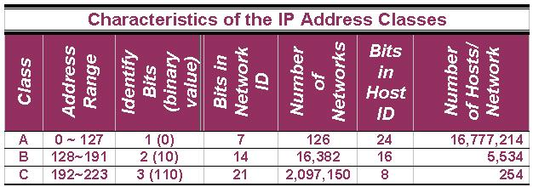
Class C IP Addresses (Cont.)

Slide 70
Special Addresses
A few addresses are set aside for specific purposes.
Network addresses that are all binary zeros, all binary ones & Network addresses beginning with 127 are special Network addresses.

Slide 71
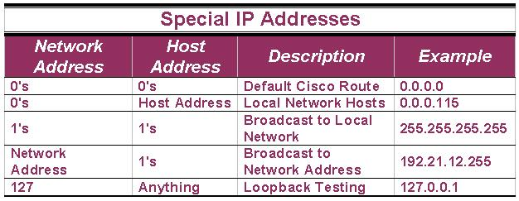
Special Addresses (Cont.)

Slide 72
Special Addresses (Cont.)
Within each address class is a set of addresses that are set aside for use in local networks sitting behind a firewall or NAT (Network Address Translation) device or Networks not connected to the Internet.

Slide 73
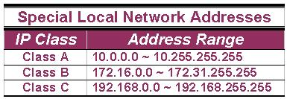
Special Addresses (Cont.)
A list of these addresses for each IP address class:

Slide 74
Network Masks
Network Masks help define which bits are used to describe the Network Part and which for hosts
Different Representations:
decimal dot notation: 255.255.224.0
binary: 11111111 11111111 11100000 00000000
hexadecimal: 0xFFFFE000
number of network bits: /19
Binary AND of 32 bit IP address with 32 bit netmask yields network part of address

Slide 75
Subnet Mask
An IP address has 2 parts:
The Network identification.
The Host identification.
Frequently, the Network & Host portions of the address need to be separately extracted.
In most cases, if you know the address class, it’s easy to separate the 2 portions.

Slide 76
Subnet Mask (Cont.)
With the rapid growth of the internet & the ever-increasing demand for new addresses, the standard address class structure has been expanded by borrowing bits from the Host portion to allow for more Networks.
Under this addressing scheme, called Subnetting, separating the Network & Host requires a special process called Subnet Masking.

Slide 77
Subnet Mask (Cont.)
The subnet masking process was developed to identify & extract the Network part of the address.
A subnet mask, which contains a binary bit pattern of ones & zeros, is applied to an address to determine whether the address is on the local Network.
If it is not, the process of routing it to an outside network begins.

Slide 78
Subnet Mask (Cont.)
The function of a subnet mask is to determine whether an IP address exists on the local network or whether it must be routed outside the local network.
It is applied to a message’s destination address to extract the network address.
If the extracted network address matches the local network ID, the destination is located on the local network.

Slide 79
Subnet Mask (Cont.)
However, if they don’t match, the message must be routed outside the local network.
The process used to apply the subnet mask involves Boolean Algebra to filter out non-matching bits to identify the network address.

Slide 80
Boolean Algebra
Boolean Algebra is a process that applies binary logic to yield binary results.
Working with subnet masks, you need only 4 basic principles of Boolean Algebra:
1 and 1 = 1
1 and 0 = 0
0 and 1 = 0
0 and 0 = 0

Slide 81
Boolean Algebra (Cont.)
In another words, the only way you can get a result of a 1 is to combine 1 & 1. Everything else will end up as a 0.
The process of combining binary values with Boolean Algebra is called Anding.

Slide 82
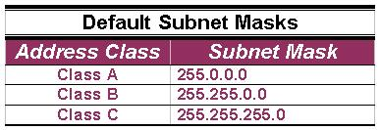
Default Standard Subnet Masks
There are default standard subnet masks for Class A, B and C addresses:

Slide 83
Classless Addressing
IP address with the subnet mask defines the range of addresses in the block
E.g 10.1.1.32/28 (subnet mask 255.255.255.240) defines the range 10.1.1.32 to 10.1.1.47
10.1.1.32 is the network address
10.1.1.47 is the broadcast address
10.1.1.33 ->46 assignable addresses

Slide 84
Forwarding
Computers can only send packets directly to other computers on their subnet
If the destination computer is not on the same subnet, packets are sent via a “gateway”

Slide 85
A Trial Separation
Subnet masks apply only to Class A, B or C IP addresses.
The subnet mask is like a filter that is applied to a message’s destination IP address.
Its objective is to determine if the local network is the destination network.

Slide 86
A Trial Separation (Cont.)
The subnet mask goes like this:
If a destination IP address is 206.175.162.21, we know that it is a Class C address & that its binary equivalent is: 11001110.10101111.10100010.00010101

Slide 87
A Trial Separation (Cont.)
We also know that the default standard Class C subnet mask is: 255.255.255.0 and that its binary equivalent is:
11111111.11111111.11111111.00000000

Slide 88
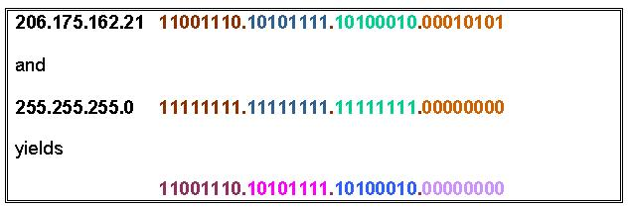
A Trial Separation (Cont.)
When these two binary numbers (the IP address & the subnet mask) are combined using Boolean Algebra, the Network ID of the destination network is the result:

Slide 89
A Trial Separation (Cont.)
The result is the IP address of the network which in this case is the same as the local network & means that the message is for a node on the local network.

Slide 90
Routing IP Addresses
When you build a network, you need to figure out how many network Ids your network requires.
To do so, you must account for every WAN connection & subnet on the Network.
Every node & router interface requires a Host address, or ID.

Slide 91
Routing IP Addresses (Cont.)
There’s no hard & fast rule on how you should dole out your allotted IP addresses.
Commonly, though, the lowest numbers (1 through 10) are assigned to routers & servers but how you assign addresses is strictly up to you & your network policies & guidelines.

Slide 92
Configuring an IP Address
The proper way to configure an IP address on the router is through the IP Address command, which assigns each router interface its unique IP address.
A router with 4 interfaces needs 4 separate IP addresses because, technically each interface (& address) is on a different network.

Slide 93
Configuring an IP Address (Cont.)
The IP Address command is entered from the config-if mode because the action affects only that interface.
Both the IP address & the subnet mask are defined in the command.

Slide 94
Verifying an IP Address
IP addresses are verified using PING, Trace & Telnet.
It is important that you know that PING is used to verify IP address connections to the Network Layer & that Telnet is used to verify network IP address connections to the Application Layer.

Slide 95
Verifying with Telnet
The reason you need to verify IP addresses is to ensure that the various parts of a network can properly communicate with the other parts.
Eg., if you can Telnet (Terminal Emulation Protocol) into a router from a remote location on the same network, you can verify that the interface & route are up and available.

Slide 96
Verifying with Telnet (Cont.)
Because Telnet operates on the OSI Model’s Application Layer, when it’s functioning, it’s safe to assume that all lower layers are also functioning.

Slide 97
Verifying with PING
The PING (Packet Internet Groper) command verifies OSI Layer 3 (Network Layer) connectivity.
It sends out ICMP (Internet Control Message Protocol) messages to verify both the logical addresses & the Physical connection.

Slide 98
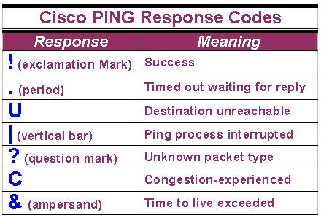
Verifying with PING (Cont.)
The PING command issued from a Cisco router responds with a number of single character responses.

Slide 99
Verifying with Traceroute
The Traceroute or Trace command is used to show the complete route from a source to a destination.
Trace sends out probe packets one at a time to each router or switch in the path between the source & the destination IP address entered.

Slide 100
Verifying with Traceroute (Cont.)
Traceroute displays the round-trip time for each packet sent to each upstream router.
Traceroute has only 2 results:
Time exceeded or
Destination unreachable.
Trace is used to determine where a breakdown in a route may be occurring.

Slide 101
Verifying with Traceroute (Cont.)
Example on how Trace is used:
A network has 4 routers (A, B, C & D). A Trace command is issued on router A to trace the route from itself to router D.
A timing response comes back from router B, but the next message indicates that router C is unreachable. You can be fairly certain that the problem lies somewhere on the route between router B & router C.

Slide 102
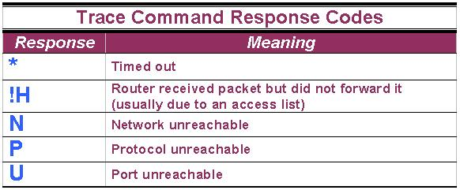
Verifying with Traceroute (Cont.)
Like PING, Trace has its own set of response codes:

Slide 103
Transport Layer Protocol

Slide 104










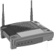







Transport services and protocols
application
transport
network
data link
physical
provide logical communication between app processes running on different hosts
transport protocols run in end systems
send side: breaks app messages into segments, passes to network layer
rcv side: reassembles segments into messages, passes to app layer
more than one transport protocol available to apps
Internet: TCP and UDP
logical end-end transport
application
transport
network
data link
physical

Slide 105
Transport vs. network layer
network layer: logical communication between hosts
transport layer: logical communication between processes
relies on, enhances, network layer services
household analogy:
12 kids in Ann’s house sending letters to 12 kids in Bill’s house:
hosts = houses
processes = kids
app messages = letters in envelopes
transport protocol = Ann and Bill who demux to in-house siblings
network-layer protocol = postal service

Slide 106
Internet transport-layer protocols
reliable, in-order delivery (TCP)
congestion control
flow control
connection setup
unreliable, unordered delivery: UDP
no-frills extension of “best-effort” IP
services not available:
delay guarantees
bandwidth guarantees
application
transport
network
data link
physical
network
data link
physical
network
data link
physical
network
data link
physical
logical end-end transport
network
data link
physical
network
data link
physical
network
data link
physical
network
data link
physical
application
transport
network
data link
physical

Slide 107
UDP: User Datagram Protocol
UDP does just about as little as a transport protocol can do.
Aside from the multiplexing/demultiplexing function and some light error checking, it adds nothing to IP. In fact, if the application developer chooses UDP instead of TCP, then the application is almost directly talking with IP.
UDP takes messages from the application process, attaches source and destination port number fields for the multiplexing/demultiplexing service, adds two other small fields, and passes the resulting segment to the network layer.
The network layer encapsulates the transport-layer segment into an IP datagram and then makes a best-effort attempt to deliver the segment to the receiving host.
If the segment arrives at the receiving host, UDP uses the destination port number to deliver the segment’s data to the correct application process.
Note that with UDP there is no handshaking between sending and receiving transport-layer entities before sending a segment. For this reason, UDP is said to be connectionless.

Slide 108
The reasons of choosing UDP over TCP
Finer application-level control over what data is sent, and when:
Under UDP, as soon as an application process passes data to UDP, UDP will package the data inside a UDP segment and immediately pass the segment to the network layer.
TCP, on the other hand, has a congestion-control mechanism that throttles the transport-layer TCP sender when one or more links between the source and destination hosts become excessively congested.
TCP will also continue to resend a segment until the receipt of the segment has been acknowledged by the destination, regardless of how long reliable delivery takes.
Since real-time applications often require a minimum sending rate, do not want to overly delay segment transmission, and can tolerate some data loss, TCP’s service model is not particularly well matched to these applications’ needs.

Slide 109
The reasons of choosing UDP over TCP(Cont..)
No connection establishment:
TCP uses a three-way handshake before it starts to transfer data. UDP just blasts away without any formal preliminaries.
Thus UDP does not introduce any delay to establish a connection.
This is probably the principal reason why DNS runs over UDP rather than TCP—DNS would be much slower if it ran over TCP. HTTP uses TCP rather than UDP, since reliability is critical for Web pages with text.
Small packet header overhead:
The TCP segment has 20 bytes of header overhead in every segment, whereas UDP has only 8 bytes of overhead.

Slide 110
The TCP Connection
TCP is said to be connection-oriented because before one application process can begin to send data to another, the two processes must first “handshake” with each other—that is, they must send some preliminary segments to each other to establish the parameters of the ensuing data transfer.
A TCP connection provides a full-duplex service: If there is a TCP connection between Process A on one host and Process B on another host, then application layer data can flow from Process A to Process B at the same time as application layer data flows from Process B to Process A.
A TCP connection is also always point-to-point, that is, between a single sender and a single receiver.
So-called “multicasting”—the transfer of data from one sender to many receivers in a single send operation—is not possible with TCP.
With TCP, two hosts are company and three are a crowd!

Slide 111
How TCP Works
Suppose a process running in one host wants to initiate a connection with another process in another host.
The process that is initiating the connection is called the client process, while the other process is called the server process.
The client application process first informs the client transport layer that it wants to establish a connection to a process in the server.
TCP in the client then proceeds to establish a TCP connection with TCP in the server.
For this the client first sends a special TCP segment;
the server responds with a second special TCP segment;
and finally the client responds again with a third special segment.
The first two segments carry no payload, that is, no application-layer data; the third of these segments may carry a payload.
Because three segments are sent between the two hosts, this connection-establishment procedure is often referred to as a three-way handshake

Slide 112
TCP Segment Structure
The TCP segment consists of header fields and a data field.
The data field contains a chunk of application data.
The MSS (Max. Segment Size) limits the maximum size of a segment’s data field.
When TCP sends a large file, such as an image as part of a Web page, it typically breaks the file into chunks of size MSS (except for the last chunk, which will often be less than the MSS).

Slide 113
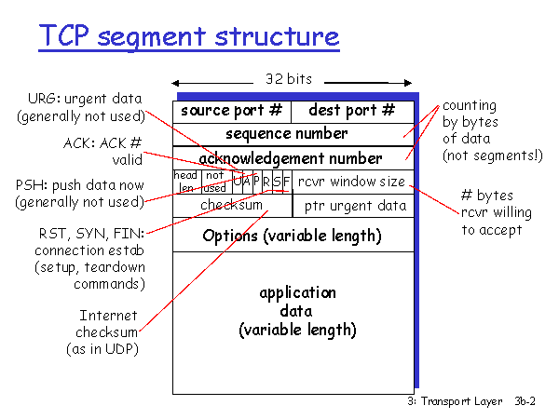
TCP Segment Structure (Cont…)
The TCP header includes source and destination port numbers, which are used for multiplexing/demultiplexing data from/to upper-layer applications.
Also, the header includes a checksum field.
A TCP segment header also contains the following fields:
• The 32-bit sequence number field and the 32-bit acknowledgment number field are used by the TCP sender and receiver in implementing a reliable data transfer service, as discussed below.
• The 16-bit receive window field is used for flow control. it is used to indicate the number of bytes that a receiver is willing to accept.
• The 4-bit header length field specifies the length of the TCP header in 32-bit words.
The TCP header can be of variable length due to the TCP options field. (Typically, the options field is empty, so that the length of the typical TCP header is 20 bytes.)

Slide 114
TCP Segment Structure (Cont…)
• The optional and variable-length options field is used when a sender and receiver negotiate the maximum segment size (MSS) or as a window scaling factor for use in high-speed networks.
• The flag field contains 6 bits.
The ACK bit is used to indicate that the value carried in the acknowledgment field is valid; that is, the segment contains an acknowledgment for a segment that has been successfully received.
The RST, SYN, and FIN bits are used for connection setup and teardown.
Setting the PSH bit indicates that the receiver should pass the data to the upper layer immediately.
Finally, the URG bit is used to indicate that there is data in this segment that the sending-side upper-layer entity has marked as “urgent.” The location of the last byte of this urgent data is indicated by the 16-bit urgent data pointer field.
TCP must inform the receiving-side upper-layer entity when urgent data exists and pass it a pointer to the end of the urgent data.

Slide 115
Sequence Numbers and Acknowledgment Numbers
TCP views data as an unstructured, but ordered, stream of bytes.
TCP’s use of sequence numbers reflects this view in that sequence numbers are over the stream of transmitted bytes and not over the series of transmitted segments.
The sequence number for a segment is therefore the byte-stream number of the first byte in the segment.
Suppose that a process in Host A wants to send a stream of data to a process in Host B over a TCP connection.
The TCP in Host A will implicitly number each byte in the data stream.
Suppose that the data stream consists of a file consisting of 500,000 bytes, that the MSS is 1,000 bytes, and that the first byte of the data stream is numbered 0.
TCP constructs 500 segments out of the data stream.
The first segment gets assigned sequence number 0, the second segment gets assigned sequence number 1,000, the third segment gets assigned sequence number 2,000, and so on.
Each sequence number is inserted in the sequence number field in the header of the appropriate TCP segment.

Slide 116
Cont…
Now let’s consider acknowledgment numbers. These are a little trickier than sequence numbers.
As TCP is full-duplex, so that Host A may be receiving data from Host B while it sends data to Host B (as part of the same TCP connection).
Each of the segments that arrive from Host B has a sequence number for the data flowing from B to A.
The acknowledgment number that Host A puts in its segment is the sequence number of the next byte Host A is expecting from Host B.
Suppose that Host A has received all bytes numbered 0 through 535 from B and suppose that it is about to send a segment to Host B.
Host A is waiting for byte 536 and all the subsequent bytes in Host B’s data stream.
So Host A puts 536 in the acknowledgment number field of the segment it sends to B.

Slide 117

TCP seq. numbers, ACKs
Host A
Host B
User
types
‘C’
Seq=42, ACK=79, data = ‘C’
host ACKs
receipt of
‘C’, echoes
back ‘C’
Seq=79, ACK=43, data = ‘C’
host ACKs
receipt
of echoed
‘C’
Seq=43, ACK=80
simple telnet scenario

Slide 118
Application Layer Protocols

Slide 119
HTTP & HTTPS
The Hypertext Transfer Protocol (HTTP) is used on the Internet to allow clients to request web pages from web servers and to allow client interaction with those web servers.
HTTP is a stateless protocol, meaning that the web servers are unaware of what a client has or has not requested and cannot track users who have requested specific content.
This system does not allow for good interaction with the web server, but it does allow for retrieving the HTML pages stored on web sites.
To aid in tracking client requests, we use cookies—small files stored on the client computer that allow the web server to store data on the client that the client will send back with each request to the server

Slide 120
The Hypertext Transfer Protocol, Secure (HTTPS) allows you to connect to a web site and to receive and send content in an encrypted format using Secure Sockets Layer (SSL), or its successor Transport Layer Security (TLS).
HTTPS is most commonly used on e-commerce sites to allow you to send personal information, especially credit card numbers and other confidential data, without worrying that an Internet hacker is viewing this information.
You can determine when HTTPS is being used because the address of the web site starts with https:// and not http://, which marks the regular HTTP protocol.
Another sign that HTTPS is in use is that a lock appears in the address bar of the browser—the lock is either closed or locked

Slide 121
DNS
The Domain Name System (DNS) service is used to convert fully qualified domain names (FQDNs) to IP addresses.
When accessing Internet sites or servers on the Internet, you use names such as www.gleneclarke.com to connect to the system.
Before a connection is attempted, your system queries a DNS server over UDP port 53 and asks the DNS server for the IP address of that system.
Once your system has the IP address of the target system, it makes a connection to that system by using the IP address.

Slide 122
SMTP, POP3 & IMAP4
The Simple Mail Transfer Protocol (SMTP) is used to send or route mail over a TCP/IP network such as the Internet.
Most e-mail server products support SMTP (TCP port 25) in order to send e-mail out of the corporation and onto the Internet.
The Post Office Protocol version 3 (POP3) is the Internet protocol used to retrieve e-mail from a mail server down to the POP3 client over TCP port 110.
The e-mail is “popped” or downloaded to the client after the client has been authenticated to its mailbox.
POP3 has limited capabilities as far as folder support is concerned.
A POP3 client supports only an inbox, an outbox, sent items, and deleted items. If additional folder support is required, you would need to use an IMAP4 client.

Slide 123
SMTP, POP3 & IMAP4(Cont..)
The Internet Message Access Protocol version 4 (IMAP4) is another protocol similar to POP3 that allows clients to retrieve messages from a mail server using TCP port 143.
IMAP4 allows additional folders other than the four basic ones provided with POP3.
For example, you can use an IMAP4 client to connect to public folders stored on a Microsoft Exchange Server.
POP3 and IMAP4 are the Internet protocols for reading e-mail, whereas SMTP is the Internet protocol for sending e-mail.

Slide 124
SNMP
The Simple Network Management Protocol (SNMP) is an Internet standard that provides a simple method for remotely managing virtually any network device that supports SNMP over UDP port 161.
A network device can be a network card in a server; a program or service running on a server; or a network device such as a hub, switch, or router.
The SNMP standard defines a two-tiered approach to network device management: a central management system and the management information base (MIB) located on the managed device.
The management system can monitor one or many MIBs, allowing for centralized management of a network.
From a management system, you can see valuable performance and network device operation statistics, enabling you to diagnose network health without leaving your office.
The goal of a management system is to provide centralized network management.
Any computer running SNMP management software is referred to as a management system.

Slide 125
SNMP(Cont…)
For a management system to be able to perform centralized network management, it must be able to collect and analyze many types of data, including the following:
Network protocol identification and statistics
Dynamic identification of computers attached to the network (referred to as discovery)
Hardware and software configuration data
Computer performance and usage statistics
Computer event and error messages
Program and application usage statistics

Slide 126
FTP
The File Transfer Protocol (FTP) is a TCP/IP protocol that exists to upload and download files between FTP servers and clients.
Like Telnet and ping, FTP can establish a connection to a remote computer by using either the hostname or the IP address and must resolve hostnames to IP addresses to establish communication with the remote computer.
When TCP/IP is installed on the system, an FTP utility is available, but a number of third-party graphical user interface (GUI) FTP clients are also available for all operating systems.
If you use FTP a great deal, a GUI FTP client could save you a lot of time and frustration in dealing with FTP commands.
FTP is a protocol that uses two ports.
TCP port 21 carries the FTP commands from one system to another, while TCP port 20 is responsible for transferring the data between two hosts in an FTP session.

Slide 127
TFTP
The Trivial File Transfer Protocol (TFTP) is a simple protocol compared with FTP and supports only reading and writing to files.
TFTP does not support features such as listing directory contents or authentication.
TFTP uses UDP as the transport protocol, and FTP uses TCP.
TFTP is typically used to copy router and switch configuration from the device to the TFTP server over UDP port 69.
TFTP can also be used to boot a device by loading the configuration that is stored on a TFTP server.

Slide 128
SFTP
The Secure File Transfer Protocol (SFTP) is an interactive file transfer protocol similar to FTP, but it encrypts all traffic between the SFTP client and the SFTP server.
SFTP supports additional features such as public key authentication and compression.
Unlike TFTP, SFTP does support a number of commands in its interactive shell, such as listing directory contents, creating directories, downloading files, and uploading files.

Slide 129
Telnet
Telnet is a terminal emulation protocol that runs on TCP port 23 and allows a client to run or emulate the program running on the server.
A number of devices allow you to “telnet” into the device and perform remote administration of the network device using the command set available to the Telnet session.

Slide 130
SSH
Secure Shell (SSH) is a program used to create a shell, or session, with a remote system using a secure connection over TCP port 22.
Once the remote session is established, the client can execute commands within this shell and copy files to the local system.
The major purpose of SSH is to support remote shells with support for secure authentication and encrypted communication; therefore, SSH should be used instead of Telnet because Telnet uses unencrypted communication.

Slide 131
SCP
The Secure Copy Protocol (SCP) is responsible for copying files from a remote server to the local system over a secure connection, ensuring that data in transit is kept confidential.
A number of SCP products use an SSH connection to ensure the security of the secure copy operation.

Slide 132
NTP
The Network Time Protocol (NTP) is used to synchronize the clocks of PCs on a network or the Internet.
This is accomplished by configuring a server to be the time server, which then is the server from which all other PCs on the network synchronize their time.
On earlier Windows networks, you can manage time synchronization by placing a command in a logon script to synchronize the time on the client with the time server.
Use the following command:
NET TIME \\computername /SET
Newer Microsoft networks such as Active Directory networks have the PDC (primary domain controller) emulator provide the time to all servers and clients automatically, so there is no need to create a logon script for the clients to synchronize the time with the time server.
PDC emulators can also retrieve their time from Internet NTP servers.
Time servers on the Internet allow you to synchronize your PC’s clock with the exact time kept by atomic clocks.
The time synchronization takes into account time zone settings of your operating system and allows you to synchronize with a time server even if it is not set for your local time zone.

Slide 133
NetBIOS
Network Basic Input/Output System (NetBIOS) is an application programming interface (API)
The primary purpose of NetBIOS is to allow applications on separate computers to communicate and establish sessions to access shared resources, such as files and printers, and to find each other over a local area network (LAN).
NetBIOS is a session layer protocol installed with other routable protocols such as TCP/IP to allow NetBIOS traffic to travel across networks.
NetBIOS has two communication modes:
■ Session mode:
Used for connection-oriented communication in which NetBIOS would be responsible for establishing a session with the target system for conversation, thus allowing large messages to be handled and provides error detection and recovery..
■ Datagram mode
Used for connectionless communication in which a session is not needed.
Datagram mode is used for any broadcast by NetBIOS.
Datagram mode does not support error detection and correction services, which are therefore the responsibility of the application using NetBIOS.

Slide 134
Microsoft uses NetBIOS names, also known as computer names, as a method of identifying systems on the network who are using NetBIOS.
A NetBIOS name can be a maximum of 16 bytes long—15 bytes for the name and 1 byte for the NetBIOS name suffix (a code at the end of the name representing the service running).
The NetBIOS computer name must be unique on the LAN.

Slide 135
NetBIOS-over-TCP/IP (NBT) can implement a central repository, or Name Service, that records all name registrations.
An application that wants to register a name would contact the name server and enquire whether the name is already registered, using a "Name Query" packet.
The name server returns a negative response if the name is not already in the database, indicating that it is available.
The Name Service, as specified in RFCs 1001 and 1002, is called NetBIOS Naming Service or NBNS.
Microsoft WINDS is an implementation of NBNS.
To start a session or to send a datagram to a particular host rather than to broadcast the datagram, NBT will have to determine the IP address of the host with a given NetBIOS name, this is done by broadcasting a "Name Query" packet, and /or sending it to the NetBIOS name server.
The response will have the IP address of the host with that name.

Slide 136
Network Security Best Practices

Slide 137
Physical Security
Ensure that all servers and networking devices such as routers and switches are stored in a secure location such as a locked server room.
You want to also ensure that you control and monitor who has access to these physical components of the network.
Do Not Use Hubs
Most environments today are using switches instead of hubs, but if you notice an old hub connected to the network, make sure to replace it with a switch so that the traffic is sent only to the port on which the destination system resides.
Configure Passwords
Most networking devices such as routers and switches allow you to configure passwords on the device, which lets you control who is authorized to administer the device.
Cisco routers and switches have a number of different passwords such as a console port password, auxiliary port password, and Telnet passwords.
Be sure each of these passwords is a complex one.

Slide 138
Use Port Security
You should also ensure that any ports on the switch that are not being used are disabled to help prevent unauthorized individuals from connecting to an available port.
In highly secure environments, you should configure port security on the ports, which is a method to specify which MAC addresses are allowed to connect to a particular port.
Port security is also a great countermeasure against MAC flooding, which involves the hacker sending frames to the switch that contain different source MAC addresses.
This could cause two things to occur:
■ The switch sees all of the bogus entries in the MAC address table and no longer trusts the table, which results in the switch flooding all frames to all ports (known as a failopen state).
■ Entries in the MAC address table are overwritten so that the switch does not know at what port valid MAC addresses are located.
When a switch does not know the location of a particular MAC address, it then floods the frame to all ports on the switch, which gives the hacker the opportunity to capture the traffic because the switch is no longer filtering traffic.

Slide 139
Use VLANs
Another important feature of a switch that should be used is VLANs because they offer a way for you to create different communication boundaries by placing ports into them.
Remember that by default a system that is in one VLAN cannot communicate with systems in another VLAN.

Slide 140
Cables and Protocol Usage

Slide 141
Cable Usages
When it comes to network cabling in highly secure environments, you should be using fiber-optic cabling because the transmission is carried through pulses of light and not through an electrical signal.
This has great security benefits because data carried through copper cabling as an electrical signal is susceptible to interference from other electrical components, whereas data transmitted over fiber optics is immune to electrical interference.
Also note that UTP cabling leaks signals, so theoretically transmissions could be listened to.
Because fiber-optic cabling does not use an electrical signal, the transmission is not leaked and therefore cannot be listened to.
Fiber-optic cabling also doesn’t lend itself to tapping into the line as easily as coax or twisted-pair communication.
It is possible for a hacker to tap into the fiber-optic line by reflecting some of the light and then converting that light to electrical information to be looked at by the hacker’s computer.
Although this attack is possible, it is also easy to detect the loss in light that is caused by this attack with the appropriate intrusion detection system on the cable.

Slide 142
Another best practice when working in large networks that involve secure and unsecured systems, or what some organizations call protected and unprotected systems, is to use different colored cables for a protected system versus an unprotected system.
Then, when assessing security, you can quickly ensure that the protected system is connected to a protected network and not to an unprotected network.
A protected network is a controlled network that is not connected to the Internet, while an unprotected network is one that is connected to the Internet.
In high-security environments, it is critical that a protected system is never connected to an unprotected network because it could be exposed to malicious software from the Internet.

Slide 143
Protocol Usage
As far as protocols are concerned, ensure that you are using the most secure protocols at all times in environments that require the security.
For example, instead of using Telnet to remotely connect to your routers and switches, you should be using SSH.
The following secure protocols should be used instead of their insecure equivalent:
■ SSH should be used instead of Telnet.
■ The scp (secure copy) command should be used instead of the copy command to securely copy information between systems.
■ Secure FTP (SFTP or FTPS) should be used instead of FTP to download and upload files.
■ HTTPS should be used instead of HTTP to encrypt web content between the client and server

